Slide 1
XPETS Module 2 Summary and User’s Manual
By Grant Buster
May 27, 2015

Slide 2
XPETS Module 2 Calibration Geometry Solver

Slide 3
Geometry Assumptions
Your system geometry is only defined by your x-ray point source, detector and turntable, NOT the test section
The detector is assumed to be a perfectly vertical plane
The detector is assumed not to be rotated in the xz plane (LEVEL IT!)
The origin is set as (0,0,0)
The xy origin is set at the turntable rotational axis
The z origin coordinate is set at the plane intersecting the x-ray point source and perpendicular to the detector plane (the z-origin plane is horizontal)
Turntable Rotation Axis
Set as Origin
X-Ray Point Source
Detector Plane

Slide 4
Importance of Geometry
An accurate 3D reconstruction is impossible without a good geometry solution
What does this mean?
4 key geometric parameters need to be defined:
Y_of (y axis distance from origin to focal/source point)
O_x (x axis distance from right hand side of detector to origin)
O_y (y axis distance from detector plane to origin)
O_z (z axis distance from top of detector to origin)
Turntable Rotation Axis
Set as Origin
X-Ray Point Source
Detector Plane

Slide 5
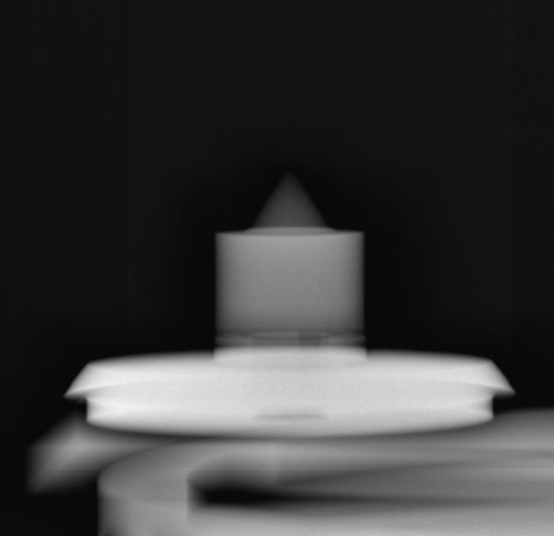
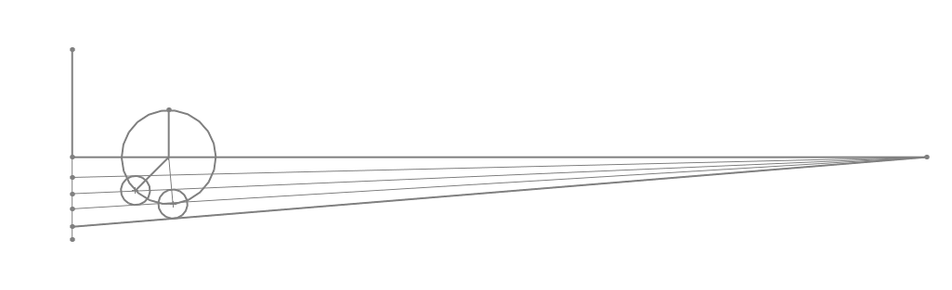
O_y and Y_of
O_y and Y_of have been defined using a machined reference geometry and Solidworks geometry solver
O_y = 0.2283 (m)
Y_of = 1.8453 (m)
These values should be considered constant unless:
The turntable is moved
The columnator or detector are moved in the y-direction (but vertical shifts should not affect O_y and Y_of)
Machined Reference Piece
SolidWorks Geo Solver (Top Down View, XY Plane)
Detector Plane
B)
Radius of Rotation
A)
C)
A)
B)
C)
Reference Piece Diameter
Reference Piece Diameter

Slide 6
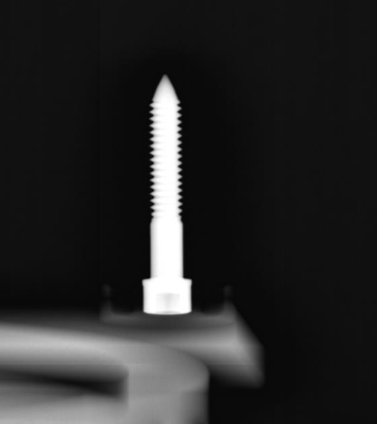
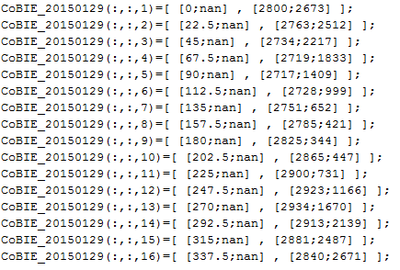
Defining O_x
We define O_x using an x-ray image set of a single point (usually a thumb screw) rotated through 360 degrees. NOTE: the screw should be placed as far off-center as possible (away from the center of the detector in z and x directions).
The angle and the i,j tip location (in pixels) (i=column#, j=row#) for each image need to be entered in the format:
Ox_DATA(:,:,1)=[ [angle;nan] , [ j ; i ] ];
Into the code: XPREX_20141029_Full_Geo_Solver.m
Example:
XPREX_20141029_Full_Geo_Solver.m

Slide 7
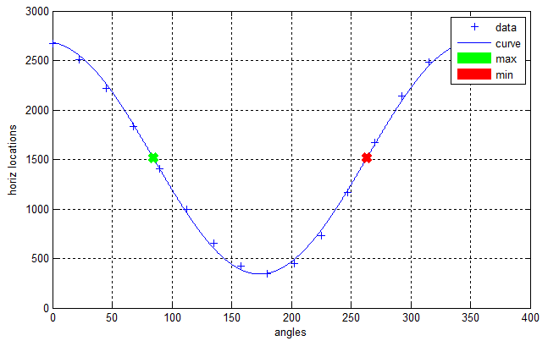
Defining O_x
XPREX_20141029_Full_Geo_Solver.m then utilizes the fact that the horizontal location of the screw tip will move in a sinusoidal path:
XPREX_20141029_Full_Geo_Solver.m will automatically calculate any angle offset and O_x
Angle offset is caused by the screw not being placed perfectly at 0-degees when the turntable is at 0-degrees. This is accounted for and it is okay to place the screw at a random angle.

Slide 8
Defining O_z
This is the (algebraically) difficult part
Start from a top-down view, in order to calculate the radius of rotation of the thumb screw tip
Radius of rotation is calculated by the following equation:
Where i is the horizontal pixel location (column index) of the thumbscrew tip in one image. This is usually taken when the screw is far right or far left. Theta in the above equation is theta of the turntable plus the theta offset
Turntable Rotation Axis
Set as Origin
Thumb-Screw
Radius of Rotation
X-Ray Point Source
Detector Plane

Slide 9
Defining O_z
We move to a side-view, in order to calculate O_z
Two images are picked, usually the two where the thumbscrew tip is highest and lowest in the image
R1 and R2 are calculated using R_rot*sin(theta), such that:
O_z is calculated as follows:
K2
K1
R2
R1
O_z
X-Ray Point Source
Detector Plane

Slide 10
Geometry Solved!
The geo.mat file should now be good to go!
Two other important parameters:
The detector has 6993 pixels per meter (PPM)
A pin/pebble diameter is 0.01257 (m)
The geo.mat file should be placed in the active directory, and loaded before module2 starts to run

Slide 11
XPETS Module 2 3D Bed Reconstruction

Slide 12
Module 2 Code Architecture
Output file
RUN_2015MMDD.m
onetwo3D_script.m
Validator.m
Render_Pebbles.m
Geo
Place3D.m
Phase1_Parallel_Find.m
Find2_W_Verify.m
Phase2_Eliminate_Outsiders.m
Thresholds
Phase3_Eliminate_Overlaps.m
Find_Contrast_1pin.m
Contrast Data
Geo
TopDownIntersection.m
Thresholds
TriangleIntersection.m

Slide 13
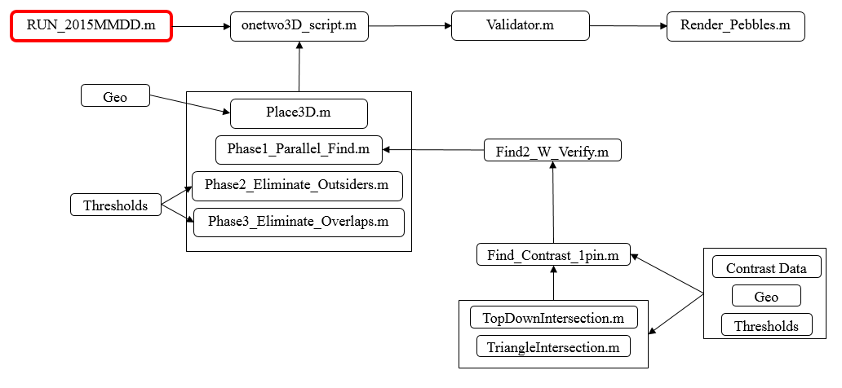
RUN_2015MMDD.m
This file will execute the following:
Setup parallel toolbox
Iterate through study timesteps
Import module1 data
Take user selected threshold values
Load geometry file
Save output file
Iterate through post processing
Validator
Render
This file is intended to hold all of the user inputs and setup parameters. High level organization.

Slide 14
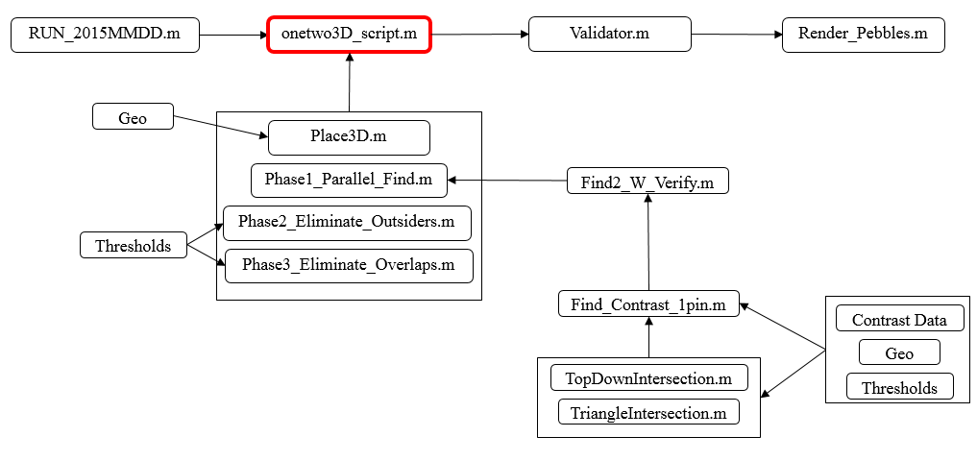
onetwo3D_script.m
This file will execute the following:
(Optional) pre select a region of module1 data
This is good for prototyping code
Selects a small region of interest for faster runtime
Place3D.m
Phase1_Parallel_Find.m
Phase2_Eliminate_Outsiders.m
Phase3_Eliminate_Overlaps.m
This file is largely organizational in nature
See details on each phase in later slides

Slide 15
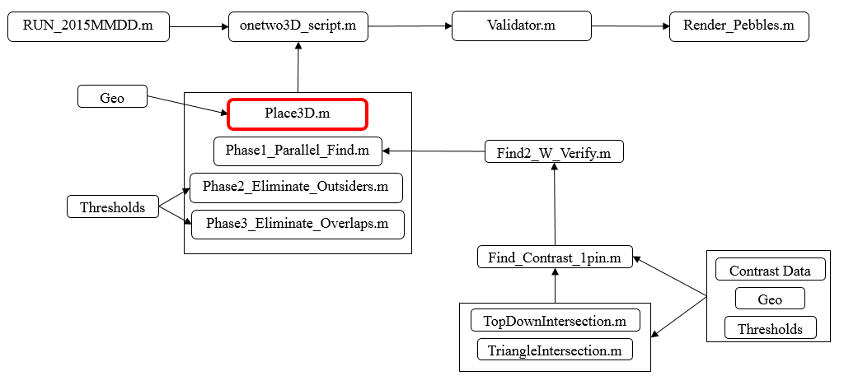
Place3D.m
This file is responsible for taking module 1 data and placing the endpoints on their respective detector planes in 3-dimensional space
Highly geometry dependent
Input (module1) (in pixels):
Output (3D in meters):
Where point 1 and point 2 should be the endpoints of a pin in an x-ray image projected onto the detector plane in 3D space

Slide 16
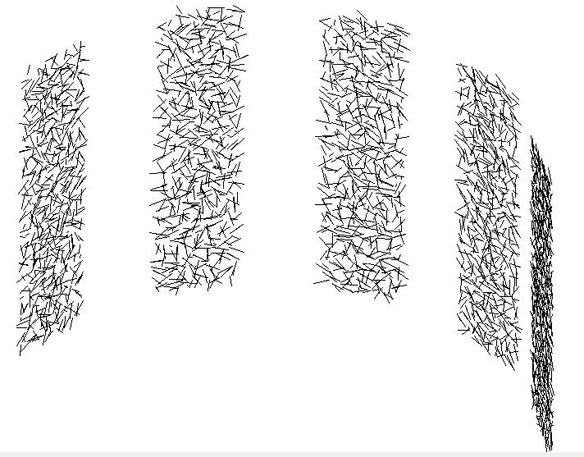
Place3D.m
Looks like this:

Slide 17
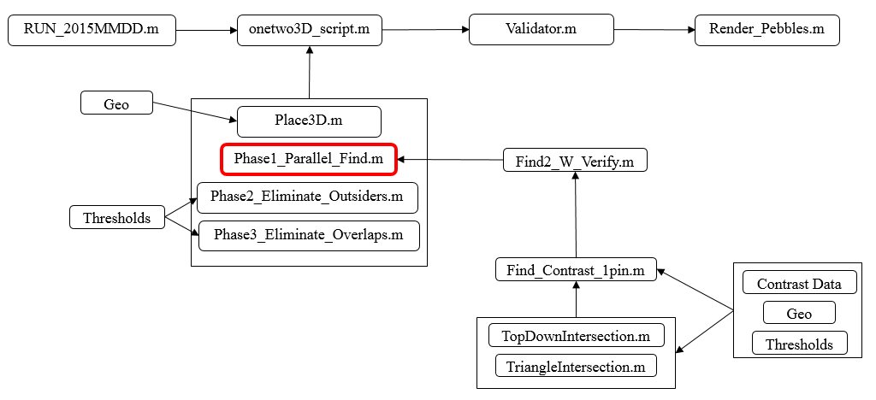
Phase1_Parallel_Find.m
This phase sets up the parallel processing inputs in a way that MATLAB will accept
This phase iterates through possible comparisons of module 1 data, running the Find2_W_Verify.m algorithm
For example, module 1 will return endpoints for 5 different detector angles
The find2_w_verify algorithm will take data sets from 2 detector angles and compare them for possible 3D results
Phase1_parallel_find.m iterates through possible input pairs for find2_w_verify.m
Phase1_Parallel_Find.m is organizational and is mostly meant to setup the parallel processing structure
Parallel processing can be easily swapped with serial by replacing the PARFOR loop with a FOR loop
Everything else should be kept the same… setup is for parallel but can also work for serial, not the other way around

Slide 18
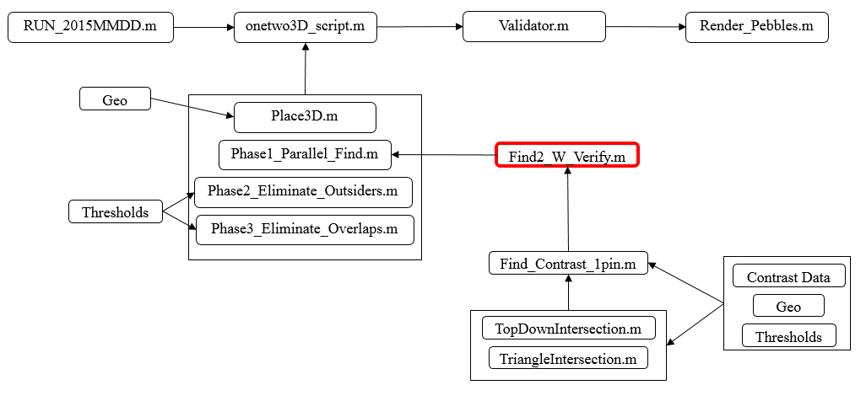
Find2_W_Verify.m
This is the main reconstruction algorithm
The function takes in two sets of pairs of endpoints
The function iterates through both sets, trying all possible comparisons between two pairs of endpoints
An initial midpoint vector calculation is done to see if they are at all close vertically (easy way to eliminate possibilities)
If pairs of endpoints are close, run intersection algorithms
TriangleIntersection.m
TopDownIntersection.m
If intersection algorithms find a solution (within set thresholds) use a contrast verification algorithm to check solution against contrast data for all five images
If contrast data is verified, add solution to output

Slide 19
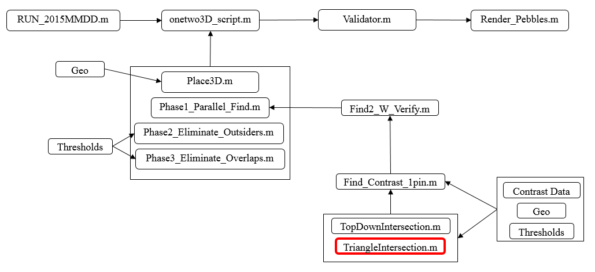
TriangleIntersection.m
A endpoints belonging to the same pin in an image form a triangle with the third point being the x-ray point source
Vector calculus can be used to compare two triangles and find their linear intersection
A good vector calculus reference can be found here: http://geomalgorithms.com/a06-_intersect-2.html
The algorithm results in two line segment solutions:
Endpoints1 as a triangle intersecting endpoints2 as a plane
Endpoints2 as a triangle intersecting endpoints1 as a plane
Thresholds used to eliminate:
Normalized length: are the linear solutions the same length as the pin’s true length (pebble diameter)?
Metric spatial similarity: are the midpoints of the two linear solutions close together?
The two linear solutions will always be perfectly parallel

Slide 20
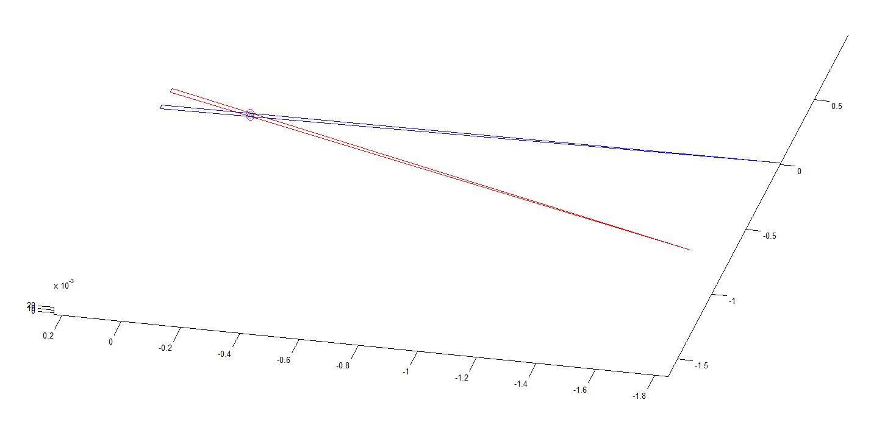
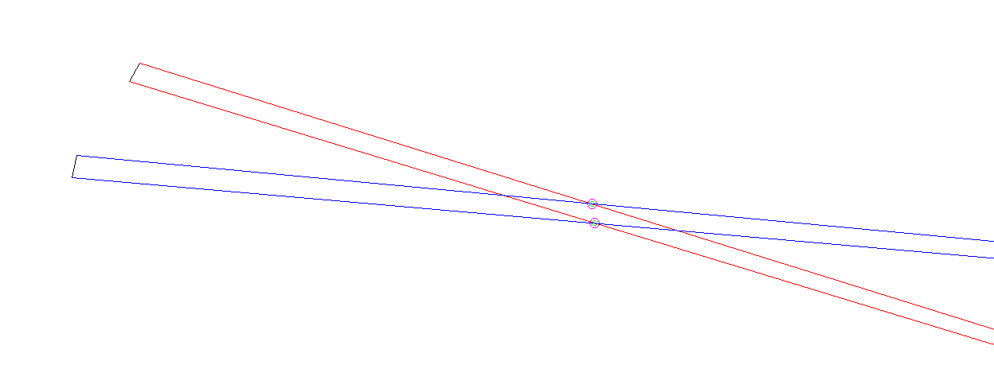
TriangleIntersection.m
This is what a triangle solutions look like:
Endpoint Pair 1
Endpoint Pair 2
Triangle/Plane 2
Possible solutions
Triangle/Plane 1
Note: In this case, the solution is valid so the two possible line solutions overlap perfectly

Slide 21
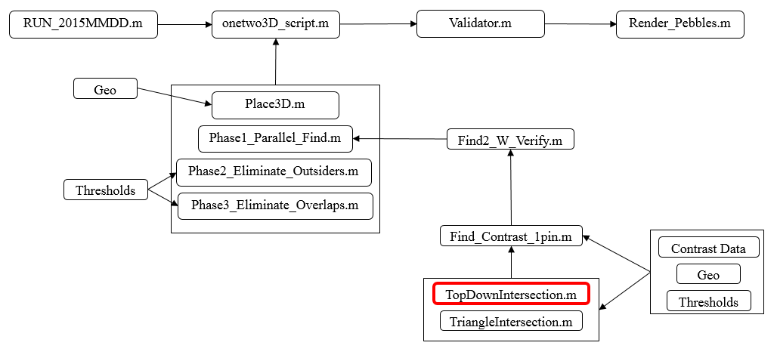
TopDownIntersection.m
As the pin approaches a horizontal orientation in the actual system, the triangle intersection method approaches massive uncertainty (think about the intersection of two near-horizontal planes)
The top down method addresses this issue by examining the intersection of the XY vector components, and then examining where these projected intersections actually lie in the 3-space
The thresholds are:
Normalized length: are the linear solutions the same length as the pin’s true length (pebble diameter)?
Metric spatial similarity: are there consistent solutions in 3-space?
This method returns more possible results than the triangle intersection method (see next slide)

Slide 22
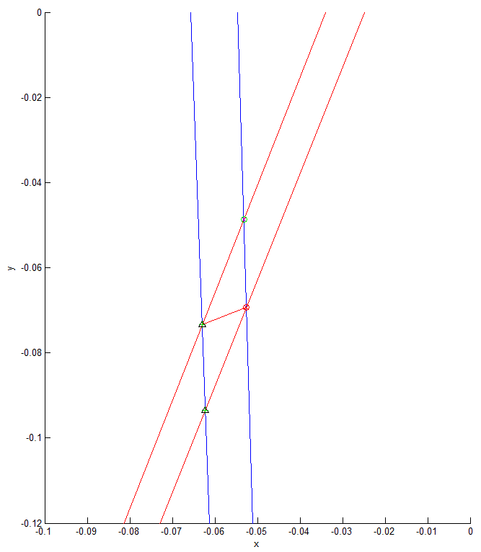
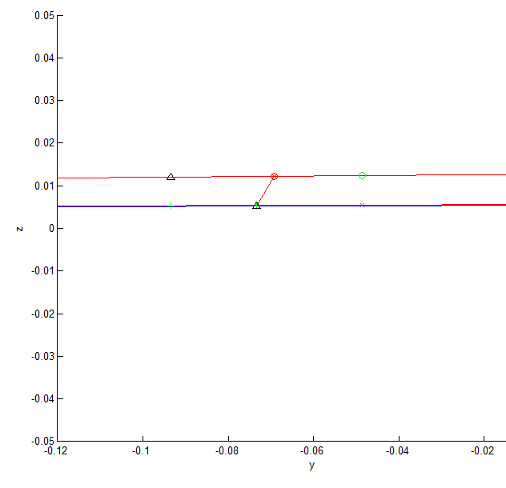
TopDownIntersection.m
The possible solutions look like this:
Top-down
Intersections
Actual
Solution
Actual
Solution
Top-down
Intersections
(possible solutions)
Top-Down View
Side View
Note: in this example, the pin is likely found by the triangle intersection method as well.

Slide 23
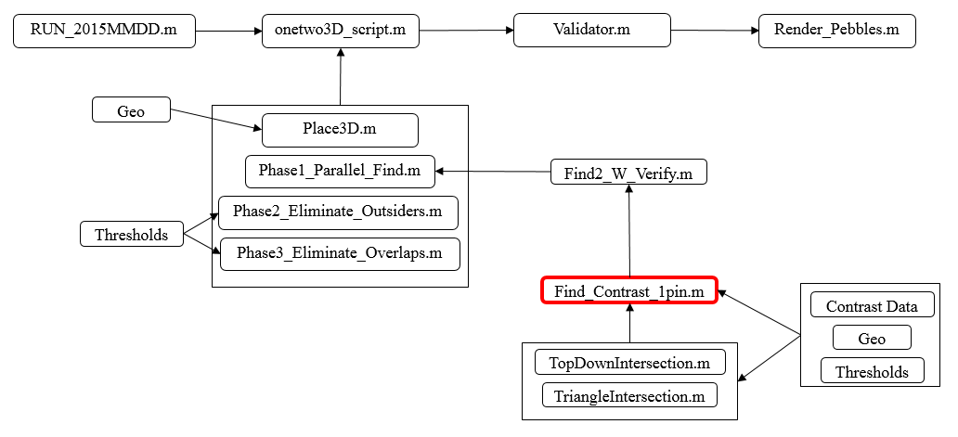
Find_Contrast_1pin.m
Every possible solution is projected onto the x-ray contrast data for every detector angle (usually 5 angles) so that it can be verified that this is indeed a pin in each image
Vector math is used for the projections
Similar to intersection algorithms
An average contrast threshold is set for each image angle (set in the run file)
5 pixels of “slop” is considered and factored into an quantitative uncertainty (in the output)
This function is called the most times, and is therefore the most computationally expensive function to run… It is, on the other hand, incredibly useful in making sure you actually found a solution

Slide 24
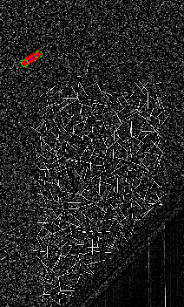
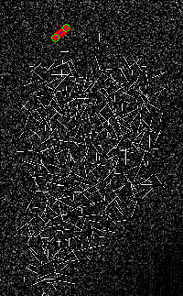
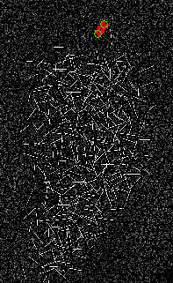
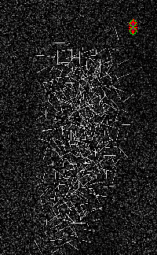
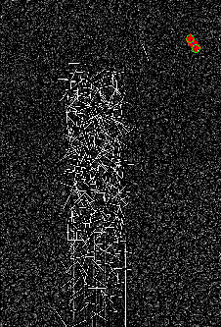
Find_Contrast_1pin.m
The contrast projection looks like this:
0-degree
22.5-degree
45-degree
67.5-degree
90-degree
The output contrast for the 5 images:

Slide 25
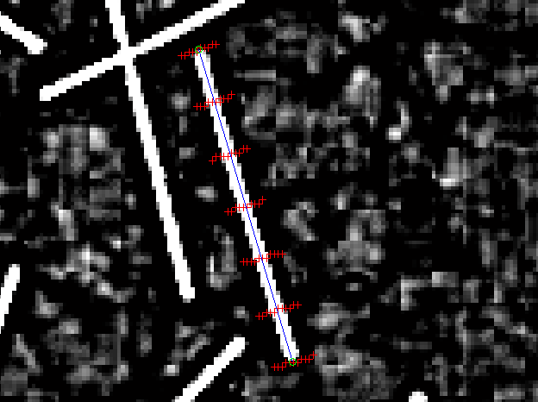
Find_Contrast_1pin.m
Detailed view:
Multiple contrast samples
account for uncertainty

Slide 26
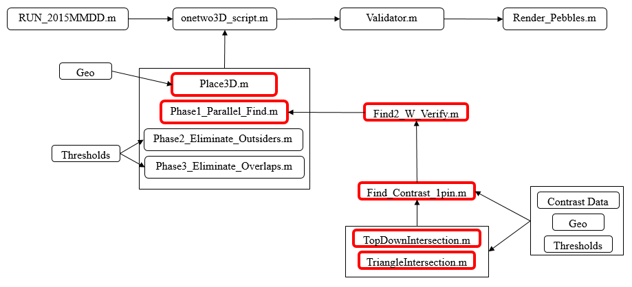
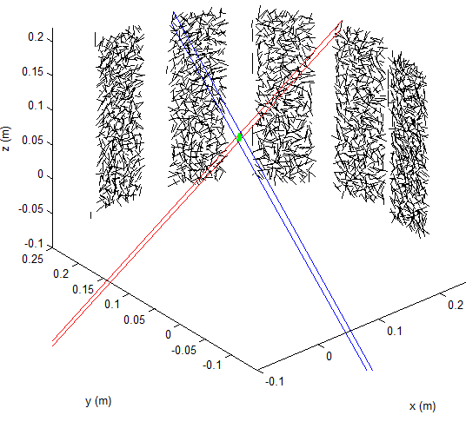
PHASE1 Summary
In summary, phase 1 looks like this:

Slide 27
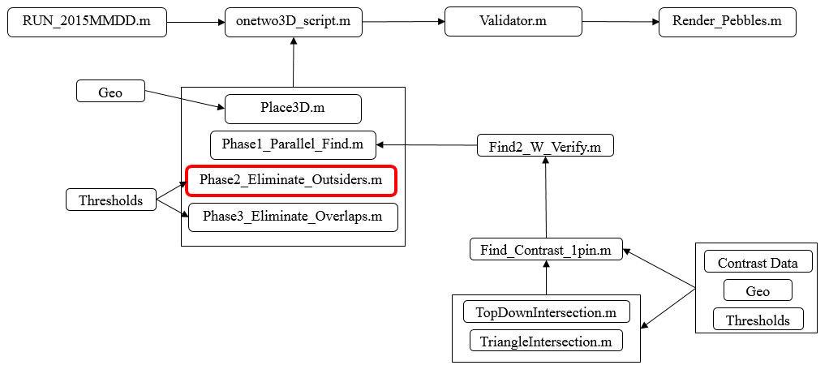
Phase2_Eliminate_Outsiders.m
This phase eliminates any possible solutions that may have been incorrectly identified as correct solutions outside of the physical silo
It uses max and min endpoints from module 1 to set silo boundaries in the 5 different views
It also uses two custom set silo boundaries at custom set angles (user input in the RUN.m file)
It only eliminates horizontal outliers using vertical boundaries

Slide 28
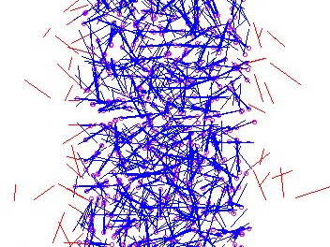
Phase2_Eliminate_Outsiders.m
Looks like this:
Note: this image was created with very liberal thresholds and the result is therefore considerably more messy than it should be. Red lines are eliminated for being outside of the silo, blue lines are solutions, pink circles are module 1 results.

Slide 29
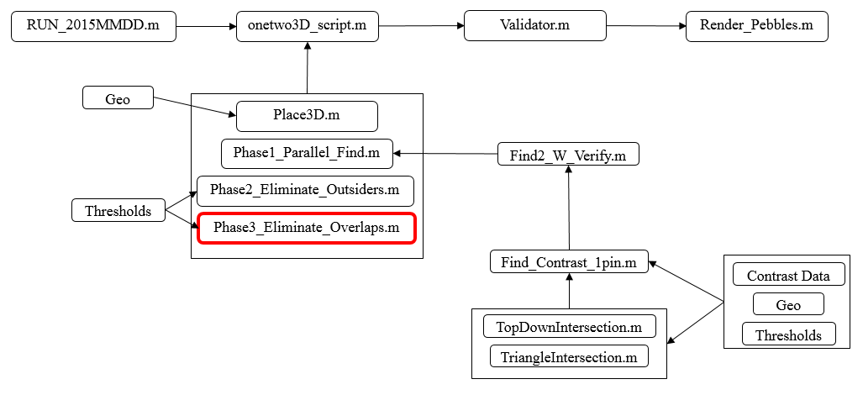
Phase3_Eliminate_Overlaps.m
This module uses the physical constraint that pebbles should contact but not overlap
An overlap threshold is set (normalized to a pebble diameter) in the RUN.m file
If any two solutions overlap more than the threshold, one is eliminated based on the uncertainty set forth by the find contrast function

Slide 30
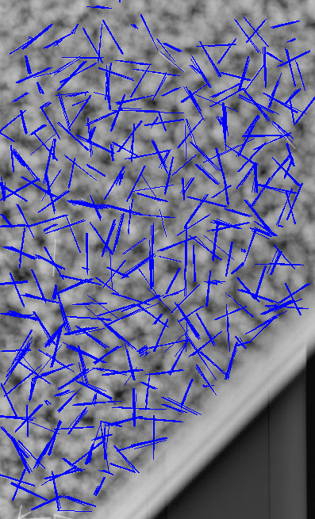
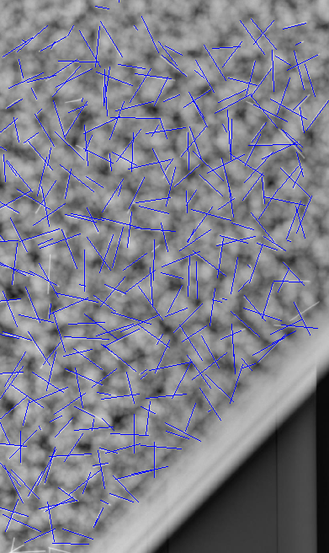
Phase3_Eliminate_Overlaps.m
Before Overlap Elimination
After Overlap Elimination

Slide 31
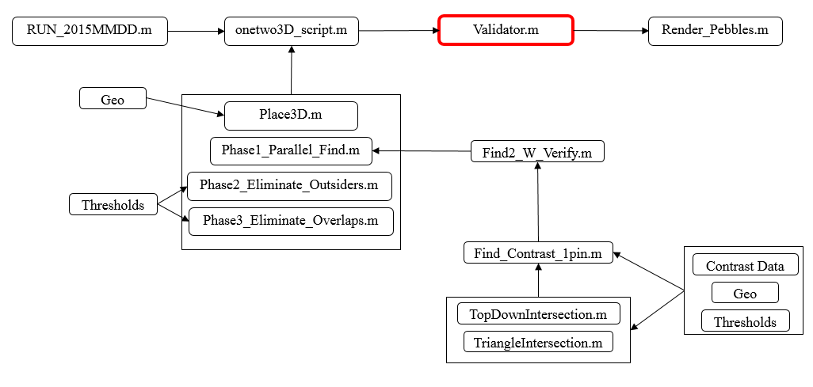
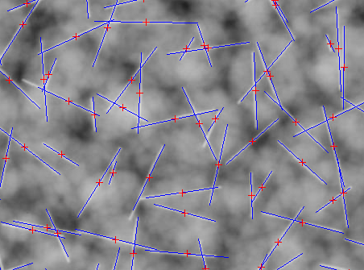
Validator.m
This simply projects the solutions onto the x-ray image so the user can visually verify the results
Various options can be found in the code for labels, image saving, module1 plotting and other “accessories”

Slide 32
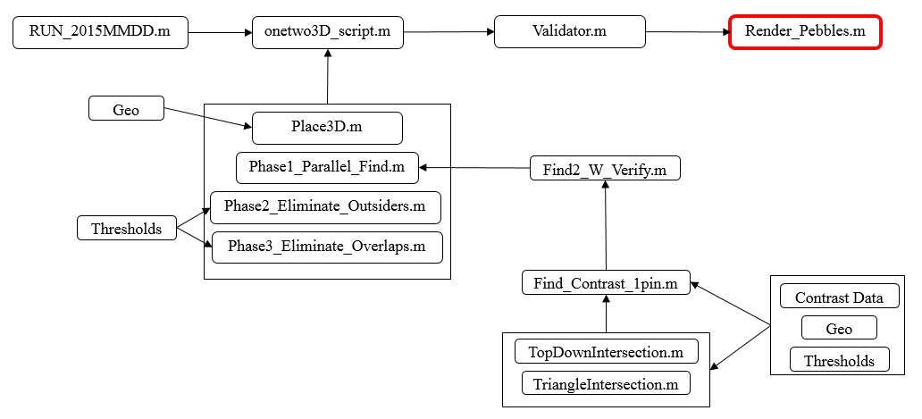
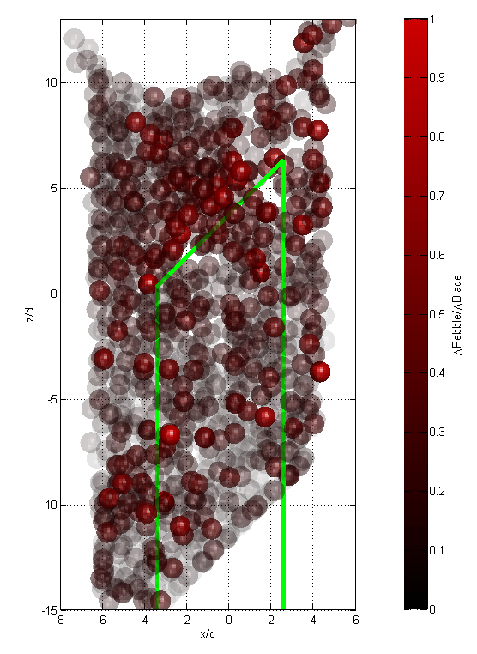
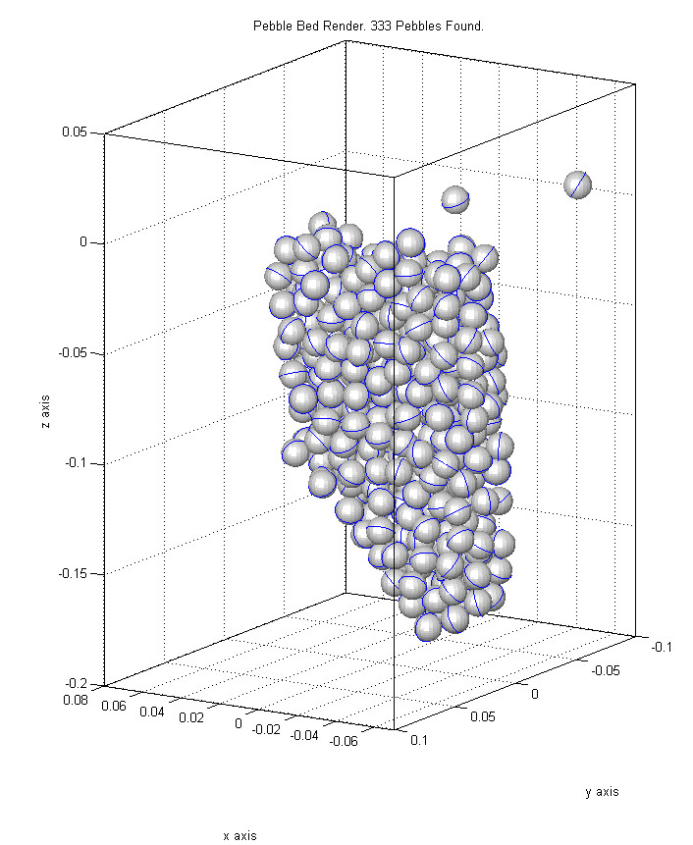
Render_Pebbles.m
This function plots pebbles with the option to plot the pebble equator, color and transparency
Very helpful for post-processing modules

Slide 33
XPETS Module 2 Summary

Slide 34
User Input Summary
Inputs found in the RUN.m file:
TriangleIntersection Thresholds
Normalized Length
0 to 1, how close to the true pin length is the possible solution? 1 is exactly the correct length
Metric Spatial
In meters. How close are the possible solutions in 3D metric coordinates? Perfectly close together (threshold=0) is a better solution.
TopDownIntersection Thresholds (also uses normalized length)
Similar Z (metric)
In meters. How close are possible solutions in the z-direction? Perfectly close together (threshold=0) is a better solution.

Slide 35
User Input Summary
Inputs found in the RUN.m file:
Elimination Thresholds
Silo Boundary (Theta, Max, Min)
If you were to take an x-ray image at the specified theta (degrees), the min and the max values (in pixels) specify left and right silo boundaries. Any solutions found to be left of min and right of max will be eliminated
Contrast Threshold
Average contrast of solution projected onto the image must be greater than the contrast threshold
Number of Valid images
The solution must have contrast greater than the contrast threshold in the specified number of images. 5 signifies that the solution must be validated in all 5 images
Normalized overlap
Fraction of a pebble diameter that two pins can overlap. 1 means two pebbles cannot overlap at all (centroids must be 1 diameter apart). 0.5 means that centroids can be 1 radius apart and not be eliminated.

Slide 36
Output Summary
Module 2 saves output files with outputs from each phase (1,2,3) as well as the related diagnostics files. Phase3 is the final output
The output data structure is as follows:
Where the 1 and 2 signify the two endpoints of a physical pin in 3-dimensions for n number of pins
And the corresponding diagnostics data structure is:
Diagnostics definitions on the next slide

Slide 37
Output Diagnostics Format Details
Length, colinearity and spatial similarity are all threshold-type variables set by the intersection algorithms
P is the 3D module 1 point (from Place3D.m) that the solution originated from
S is the 3D source point corresponding to P
C is the average contrast of the solution in each image (1-5)
U is an uncertainty parameter set by the find contrast algorithm

Slide 38
DON’T PANIC Always feel free to call 720-495-6245 or email grantbuster@gmail.com

